Slide 1
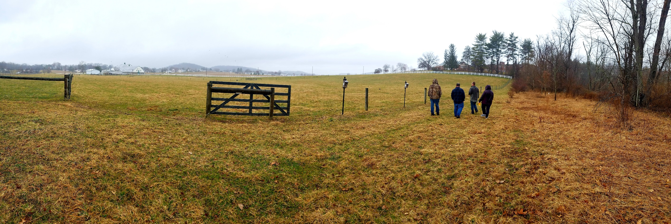
Welcome to Lycoming County’s Countywide Action Plan (CAP) Check-In Meeting
Notes:
Purpose of today’s meeting is to discuss Draft 1, talk about Peer Group updates, and to plan for next steps in the planning phase
Chat – rename yourself (First, Last Name – Affiliation); type in your name, affiliation, and any other participants joining you in the meeting
Let me know if you do not have audio
Poll function

Slide 2
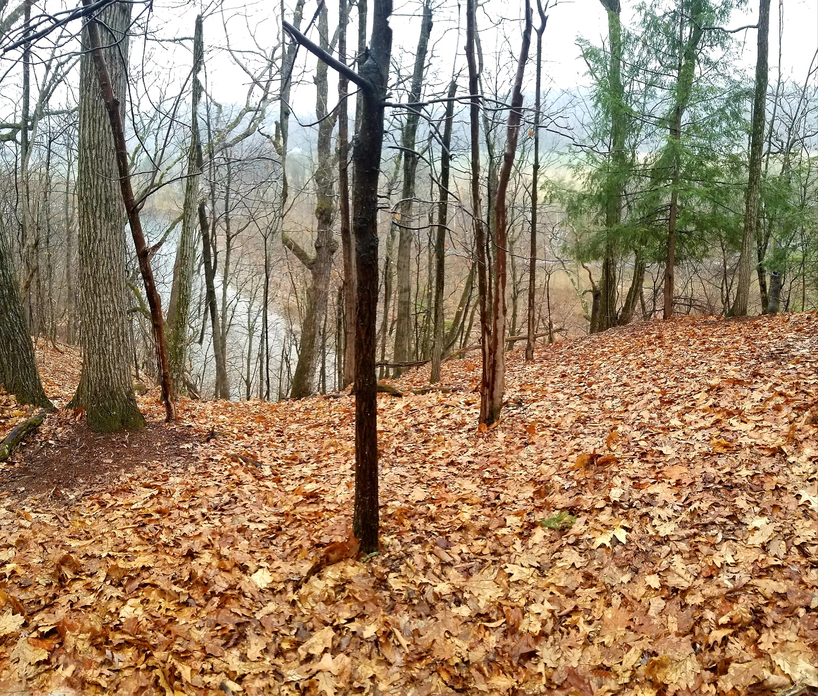
Meeting goals:
Discuss Draft 1
Quantifying Projects
Leveraging Resources
Solidifying Partnerships
Cover Peer Group Updates
Plan Next Steps

Slide 3
Meeting agenda:
Updates
Draft 1 Planning
Questions/Concerns
Next steps

Slide 4
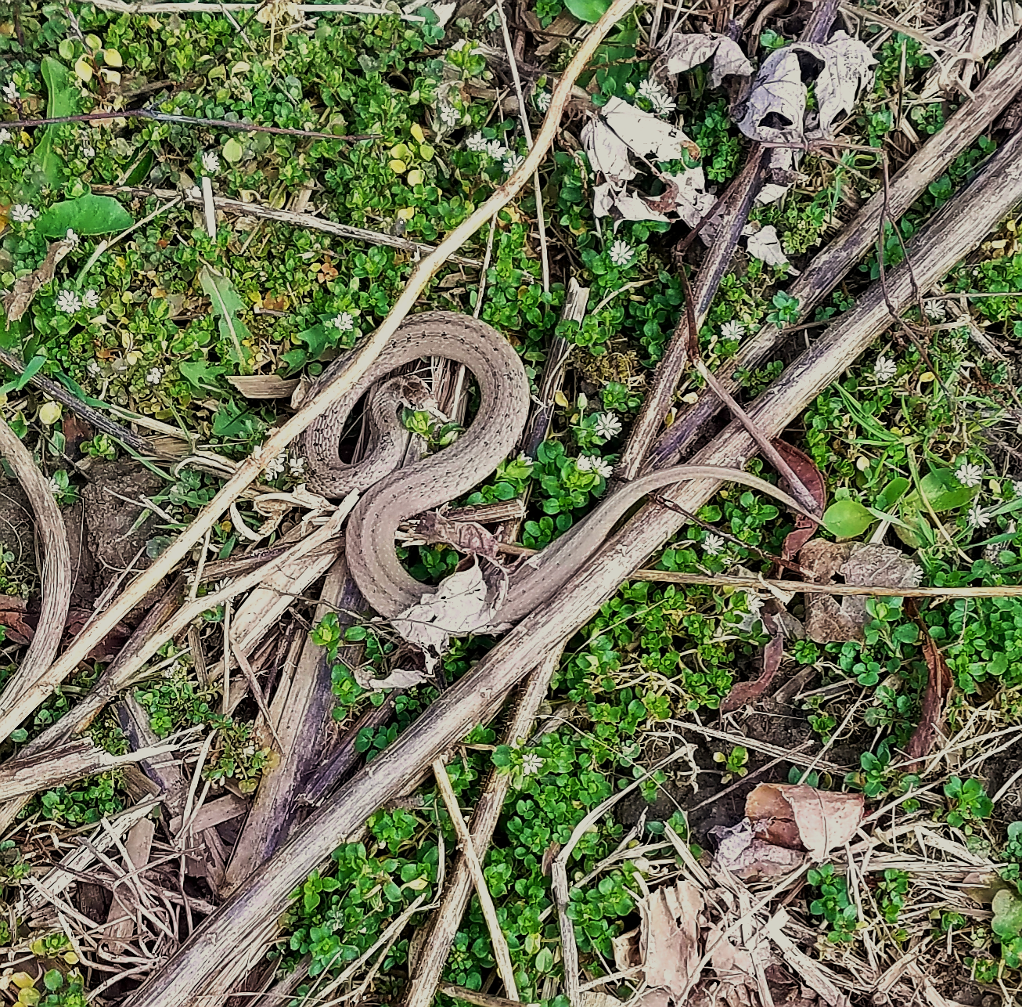
Updates
Resources Peer Group will be absorbed into other groups
We have a newsletter!

Slide 5
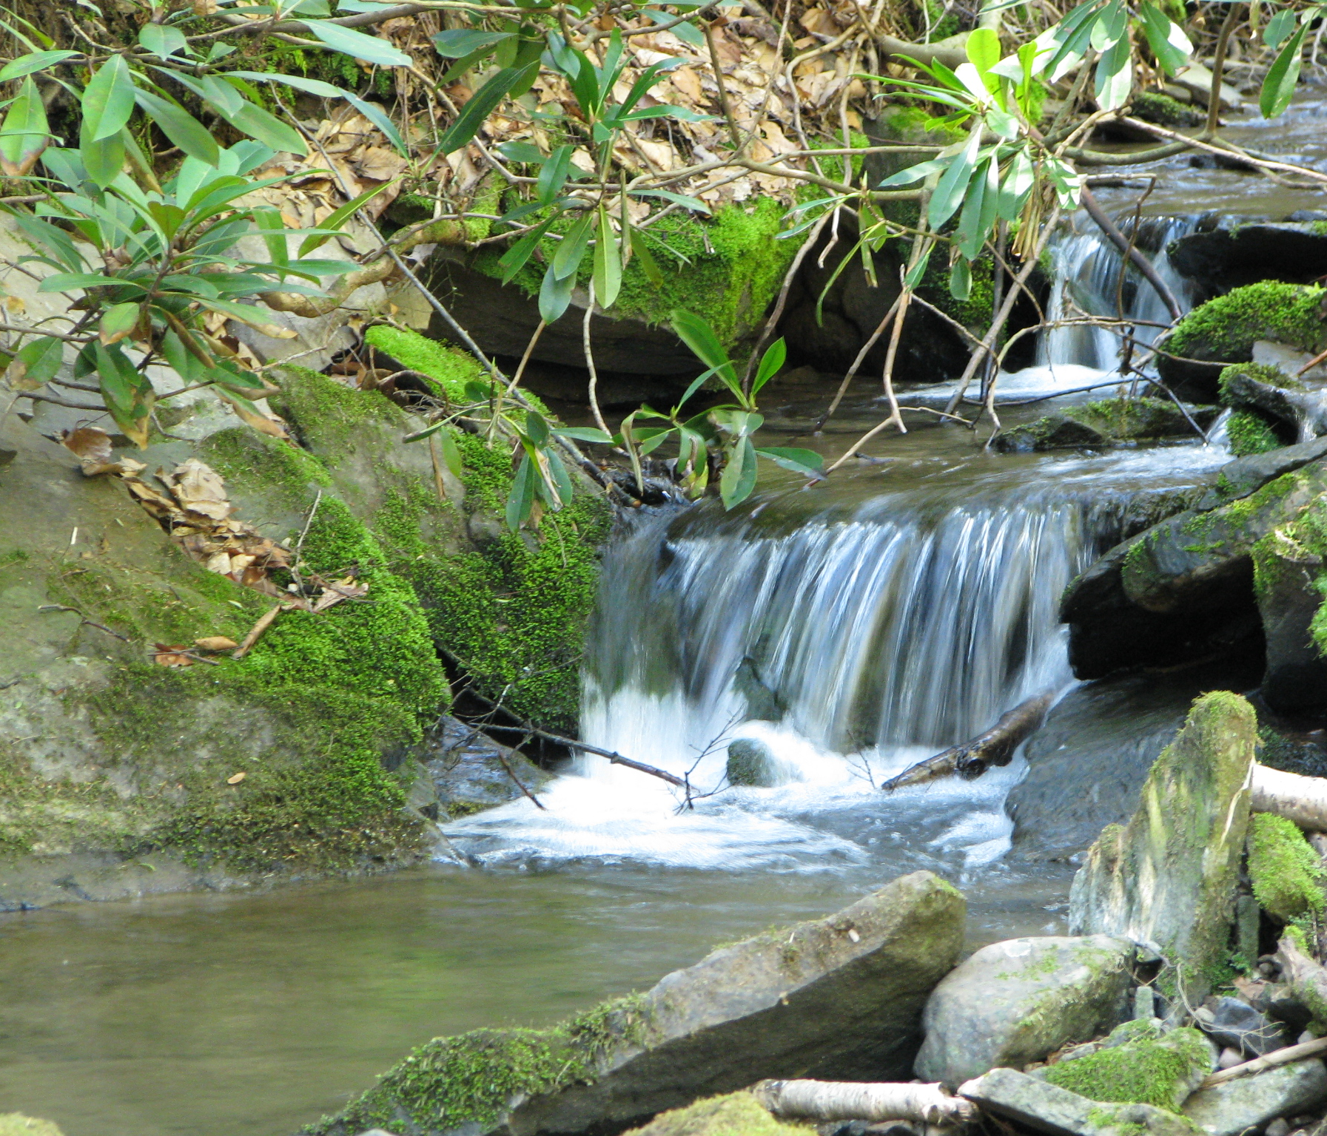
Draft 1 Planning
Quantifying Projects
Leveraging Resources
Solidifying Partnerships
Notes:
Turf field nutrient management, pg 3
Public/private farm BMP sponsorship program, pg 4
Expand inter-agency collaboration, pg 5
Improving and expanding technical assistance, pg 6
Expand dirt and gravel roads program, pg 9

Slide 6
Prioritization Poll
What do you think is the best way to prioritize projects?
Highest load reduction
Lowest cost
Most public buy-in
Least amount of time it would take to finish
Most co-benefits
Something else?
Are you interested in participating in the Implementation Peer
Yes
No
Notes:
If you respond “something else” please write your response in the chat function if you do not have audio.
An option that was brought up was to create a scoring system for projects where certain qualities a project may have are assigned a numeric value. Do you think this is a good idea for us to use?
What other ideas or suggestions do you have?
My hope for the Implementation Peer Group is to have an even representation of all of the other peer groups. Please also know that any decisions made regarding prioritization and implementation will not be done in a black box and will be discussed with the larger group of stakeholders because the last thing I want is for you to feel like there isn’t any transparency. And please let me know if you feel that way at any point.

Slide 7
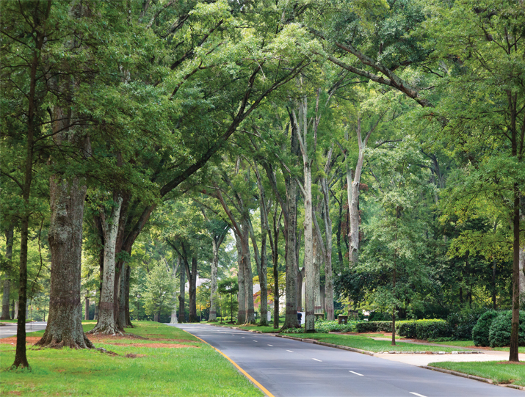
What Questions or
Concerns do you have?

Slide 8
Next steps
Meetings
Planning
Next check-in meeting is Thursday, May 27th at 9:30am
Implementation Peer Group meeting Tuesday, May 25th 1-3pm
Recruit!
Come prepared and ready for discussion
Strategize based on Draft 1 reductions
Prioritization strategies
Public engagement
Draft #2 due Thursday, June 24th

Slide 9
Eve Adrian Lycoming County Natural Resource Planner eadrian@lyco.org 570-329-4761 For more information visit https://www.lyco.org/CWAP

Slide 10
Photo credits
Northcentral PA Conservancy
Trees Charlotte – Charlotte NC tree canopy

